Slide 2
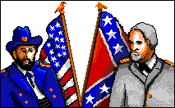
What is a “civil” war?
A war between states or regions in the same country
In the United States’ Civil War, the opposing forces were the North and the South

Slide 3
The Civil War and Slavery
Lasted between 1861-1865
Slavery was one of the largest causes of this war. Abolitionists fought against slavery.
Slavery– a system under which people are treated as property to be bought and sold, and are forced to work

Slide 4
The North vs. the South
Slavery was illegal in the Northern states of the country
The North was commonly referred to as “The Union” or the Yankees
The North was more populated than the South, had large cities, and many factories

Slide 5
The North vs. the South
Slavery was still in practice in the South
Agriculture (farming) was big business in the South, and many argued that slave labor was a necessity for their industry
The South wanted to remove itself from the United States and form a country of its own, known as The Confederate States or the Rebels

Slide 6
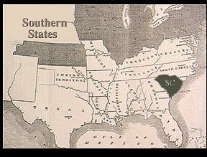
Seceding from the Union
Slowly, many Southern states did just that, and declared themselves no longer part of the United States of America
This was called “seceding” from the Union
South Carolina was the first state to leave from the Union

Slide 7
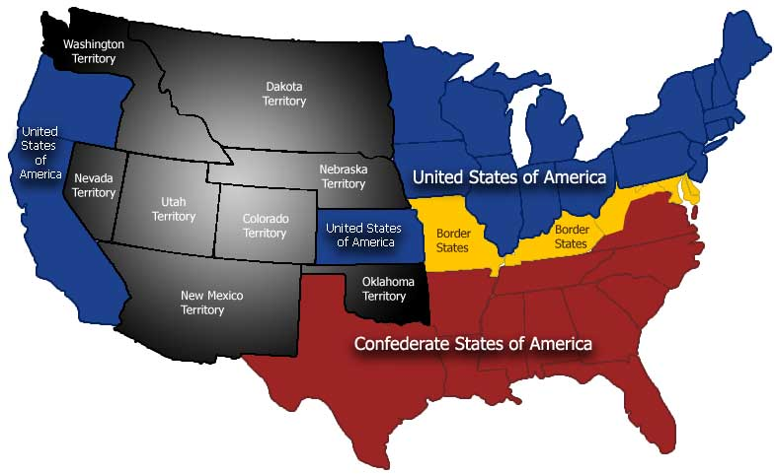

Slide 8
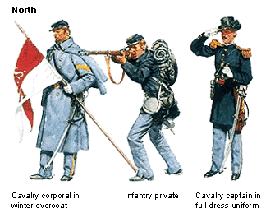
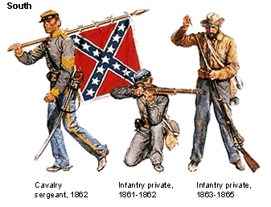
Soldiers
North– Blue uniforms
South– Gray uniforms

Slide 9
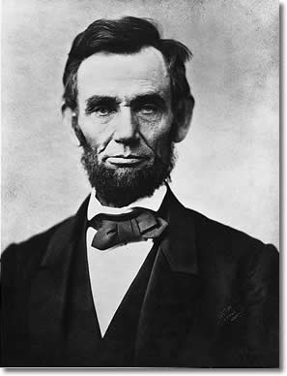
U.S. President
Abraham Lincoln was the 16th president of the United States and the president in office during the Civil War

Slide 10
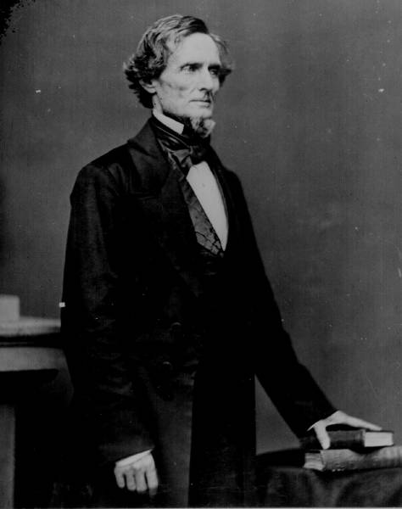
The Leader of the Confederacy
Motto: “With God as our Vindicator”
President Jefferson Davis

Slide 11
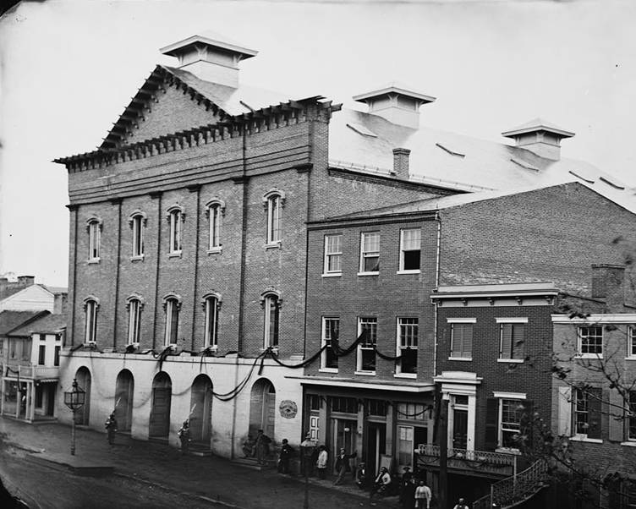
Ford’s Theater (April 14, 1865)

Slide 12
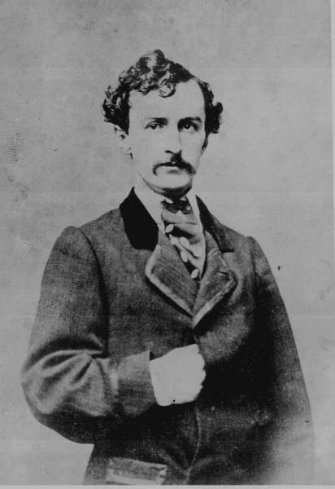
The Assassin
John Wilkes Booth was a famous actor at Ford’s Theater in Washington, D.C.
Though he lived in the North, he supported the South and their fight to protect slavery

Slide 13
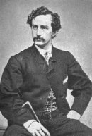
John Wilkes Booth
Met with several other people and planned to kidnap the president, to exchange him for Southern prisoners
Booth was unsuccessful, and changed his plan to assassinate Lincoln instead on April 14, 1865 while viewing a play at Ford’s Theater

Slide 14
