Slide 1
Non-Fiction Notice and Note Signposts

Slide 2
What is a Signpost?
When you’re driving a car,
you notice the signs and
respond accordingly.
It’s the same with reading:
common patterns, or “signs,”
become recognizable, and you should respond.

Slide 3
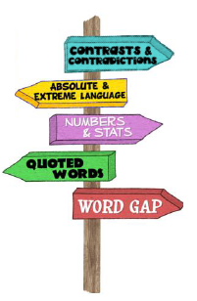
In reading, we call these signs “signposts.” These are places you recognize as important and where you need to stop, notice, and ask yourself a question.

Slide 4
What is NonFiction?
Nonfiction is that body of work in which the author purports (appears or claims) to tell us about the real world, a real experience, a real person, and idea, or a belief.
Nonfiction is the stuff of real life—life with all its contrast and contradictions, all its tough questions and aha moments, all its half-truths, and little white lies, its moments when we have to say, “Well, let me clarify” or “That was taken out of context” or “What I really meant.”
Easy definitions like not fake, true, or real might NOT be the best definition because some nonfiction is not true. Nonfiction is the author’s attempt to represent actual facts but may be slanted or biased.

Slide 5
Three BIG Questions:

Slide 9
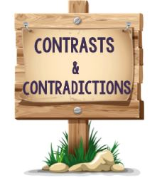
Today we'll be learning about the 1st signpost.
Contrasts & Contradictions

Slide 10
Notice & Note- Nonfiction
When you're reading and the author shows you a difference between what you know and what's happening in the text, or a difference between 2 or more things in the text.
You should STOP and ask yourself:

Slide 11
What is the difference and why does it matter?
?

Slide 12
Lets see how contrasts and contradictions show up in text. Sometimes it's very obvious!

Slide 13
"On the other hand" is the author's signal that he's going to show how Athens differed from Sparta
Sparta was content to keep to itself and provided army assistance when necessary. Athens, on the other hand, wanted to control more and more of the land around them.

Slide 14
We were tipped off by the phrase "even though" that something we would expect to happen isn't going to.
Even though the temperature dipped below 32 degrees, the water did not freeze.

Slide 15
Words that Signal a
Contrast or Contradiction
Alternatively
By contrast
However
Nonetheless
Otherwise
Then again
Unlike
Although
Different from
Instead
On the other hand
Still
Yet

Slide 16
Let’s work together to identify more Contrasts & Contradictions
video

Slide 18
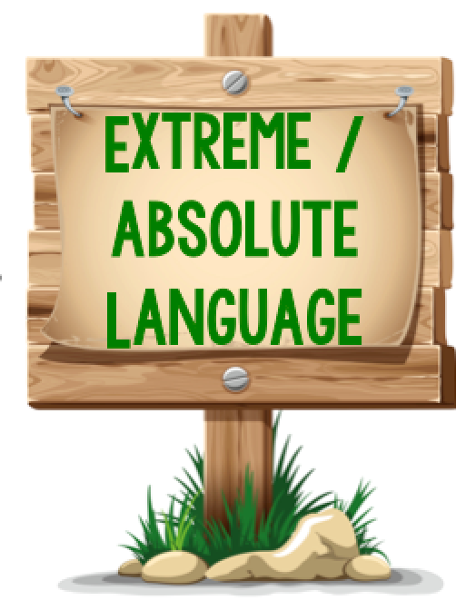
Today we'll be learning about the 2nd signpost.
Extreme/Absolute Language

Slide 19
Notice & Note- Nonfiction
When you're reading and the author uses language that leaves no doubt, exaggerates, or pushes the limit,
You should STOP and ask yourself:

Slide 20
Why did the author say it like that?
?

Slide 21
These are all Examples of
Extreme Language

Slide 22
Let's take a look at some of the statements I've heard students making:
I've told you a million times
This class lasts forever.
I have to go to the restroom. It's an emergency!

Slide 23
Lets see how Extreme Language shows up in text.

Slide 24
"no one" How could he know that?
"irreversible" If It's already irreversible we must be doomed!
"No one on this planet will be untouched by climate change," the Intergovernmental Panel on Climate Change announced. The report warned that climate impacts are already severe, pervasive, and irreversible.

Slide 25
When I see Extreme Language that is troubling, I have an obligation to think about it, wonder why, and recognize that these are clues to the author's purpose.

Slide 26
Let’s work together to identify more Extreme Language

Slide 27
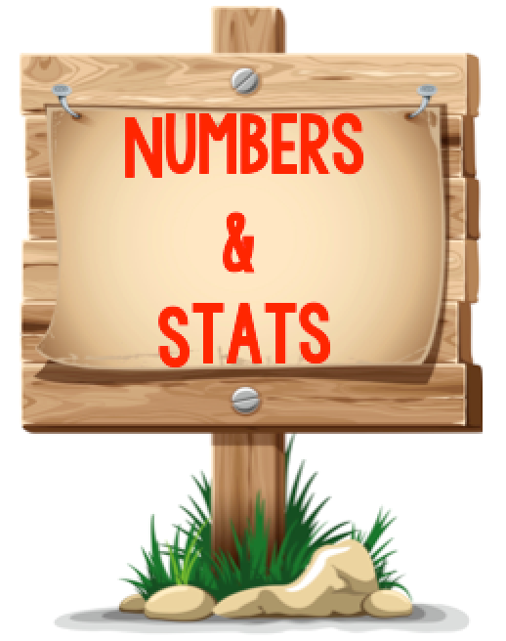
Today we'll be learning about the 3rd signpost.
Numbers & Stats

Slide 28
Notice & Note- Nonfiction
When you're reading and you notice specific numbers, number words or amounts
You should STOP and ask yourself:

Slide 29
Why did the author use those numbers or amounts?
?

Slide 30
The main reason we use numbers is to give specific details to help you better understand.

Slide 31
We will sometimes realize that the reason was not important.
Other times, though, you'll discover it was to help you visualize something, make an inference, draw a conclusion, figure out what is fact and what is opinion, or find out if an author is bias.

Slide 32
Lets see how numbers and stats show up in text.

Slide 33
Notice some of the numbers are written out as words, an that's okay.
When I ask myself "why did the author include these numbers?" I realize that all of them give me information about where Garana is living.
Garana and her family lived in their one-room house for two years. It's one of thousands of mud brick homes in Shamshatoo Afghan Refugee Camp. The camp holds about 50,000 Afghan refugees.

Slide 34
When I ask myself "why did the author include these numbers?" I think the author wants me to realize that it is ridiculous that we spend that much more on bottled water;.
In fact, nearly half of all bottled water is reprocessed tap water, sold at prices up to 3,000 times higher than consumers pay for tap water.

Slide 35
When I ask myself "why did the author include these numbers?" I don't see anything that makes his age special. Sometimes, authors provide details that don't change our thinking
The singer, 28, joined us for the interview..

Slide 36
Let’s work together to identify more Numbers and Stats

Slide 37
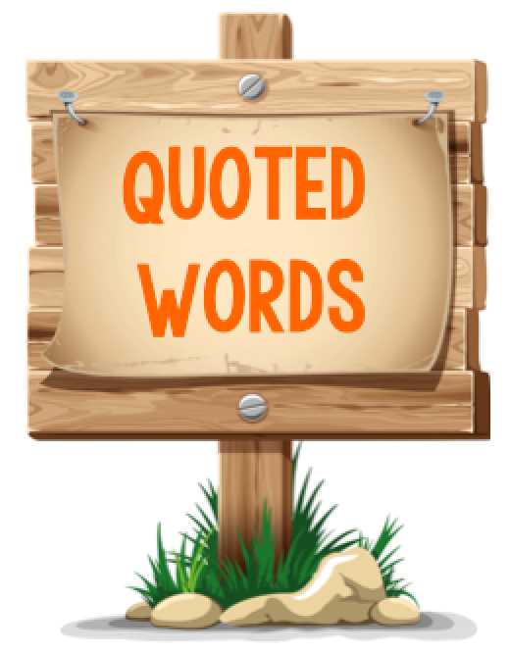
Today we'll be learning about the 4th signpost.
QUOTED WORDS

Slide 38
Notice & Note- Nonfiction
When you're reading and you notice the author quoted a voice of authority, a Personal Perspective, or cited others' words,
You should STOP and ask yourself:

Slide 39
Why did the author quote this person?
?

Slide 40
I want to share some comments I've heard from kids, what do they have in common?
Why does conversational talk often include quoting someone else?
"Did you hear what she said? She was like, ‘It’s not my fault` and saying that over and over again, but everyone knew it was”
"So then, he went ‘so, let's all go to the game,’ but then she said, ‘No, let’s all go to the mall,’ and it was like no one could decide.“
“The teacher said that this wouldn’t be on the test. Remember, her exact words were, 'you do not have to study this section because it will not be on the test` and so I didn't.

Slide 41
Authors do the same thing- quote people to help make text more interesting or to help prove a point.
Let’s take a look at what Quoted Words look like in a text

Slide 42
The first paragraphs focused on how the questions on the immigration test will change. When I notice the author using a quote I have to STOP and ask myself:
We don’t know who Emilio is, but the author tells us what he does. As director of Citizenship and Immigration Services, he must have an opinion on the changes.
Why was that person quoted?
The author is using voice of authority of someone who supports the change.
“The goal is to make it more meaningful,” says Emilio Gonzalez, director of Citizenship and Immigrations Services… “You really ought to know what you’re swearing allegiance to,” he says

Slide 43
When I notice the author using a quote I have to STOP and ask myself:
Why was that person quoted?
Drought relief did not come this winter- California’s wet season- as hoped. Though California is the third-largest state in the land mass, nearly all of the state is abnormally dry at best, and in exceptional drought at worst.
“There’s been a drought of some extent for multiple years now, and it doesn’t look like it’s going to be ending anytime soon,” Storm Shield meteorologist Jason Meyers said.

Slide 44
This is a Personal Perspective that is not just about one girl, but about all of the children workers.
At the beginning of a chapter in a book about how children had to work in mills that turned cotton into thread, the author shares this quote:
“I shall not stay here… Up before day, at the clang of a bell and out of the mill by the clang of a bell- just as though we were so many living machines.”

Slide 45
Let’s work together to identify more Quoted Words

Slide 46
Today we'll be learning about the 5th signpost.
Word Gaps

Slide 47
Notice & Note- Nonfiction
When you're reading and you notice the author uses a word or phrase you don’t know
You should STOP and ask yourself:

Slide 48
Do I know this word from someplace else?
Can I find clues in the sentence to help me understand the word?
Does this seem like technical talk for experts?
?

Slide 49
Let’s work together to identify more Word Gaps

